Slide 1

Business Insight 360
Company: AtliQ Hardware
By: K M Dinesh

Slide 2
Agenda
Introduction
About the Company
Problem and Objective
Company Model and Data Model
Dashboard
Key Measures

Slide 3
Introduction
﻿
Welcome to Project Business Insight 360, where I create a comprehensive Power BI dashboard to drive data-driven decision-making at AtliQ
Hardware. By offering critical insights into financial performance, market trends, Supply chain ,Executive view and operational efficiency.
This dashboard will empower the company to make informed strategic choices, optimize operations, and enhance profitability. This initiative is vital for AtliQ Hardware to stay competitive, strengthen its market position, and ensure future success.

Slide 4
About the Company
﻿
AtliQ Hardware is a fast-growing company that has expanded its business worldwide. Specializing in computers and accessories, AtliQ has quickly become a global force in the tech industry. The company offers a wide range of products, including high- performance desktops, laptops, servers, and essential peripherals like keyboards, mice, monitors, and storage devices. With a strong international distribution network and strategic industry
partnerships, AtliQ ensures its products are available to customers everywhere, making it a trusted name in the tech world.

Slide 5

Problem
AtliQ Hardware, a rapidly growing consumer electronics company with operations in multiple countries, is facing significant challenges due to outdated data analytics practices. Despite their growth, they continue to rely on Excel files for data management, leading to inefficiencies and difficulty in generating actionable insights. This limitation recently contributed to a substantial loss in our Latin American market. It's crucial for AtliQ Hardware to transition to more advanced and integrated data analytics solutions to harness our full potential, optimize decision- making, and prevent future setbacks.

Slide 6
Objective
﻿
To transition AtliQ Hardware from relying on Excel files to an advanced, integrated data analytics solution. This will enable the company to effectively generate actionable insights, optimize decision-making processes, and prevent future losses, particularly in key markets such as Latin America. The ultimate goal is to enhance operational efficiency, support sustained business growth, and maintain a competitive edge in the consumer electronics industry.

Slide 7
Company Model

Slide 8
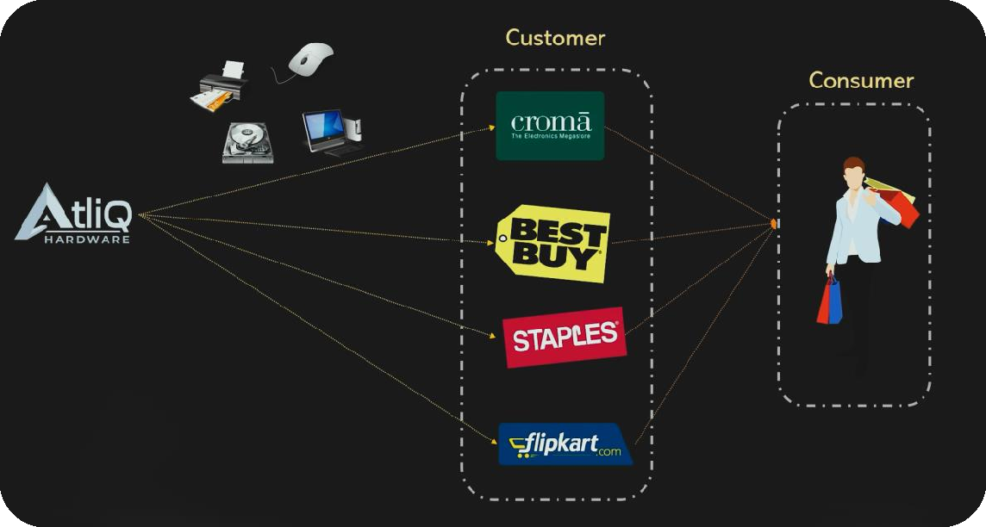

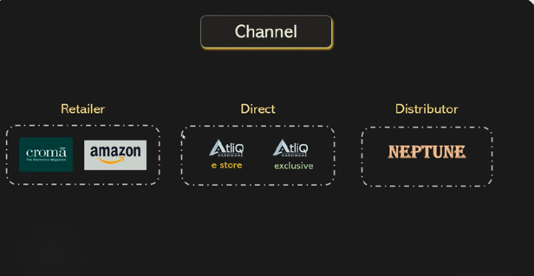
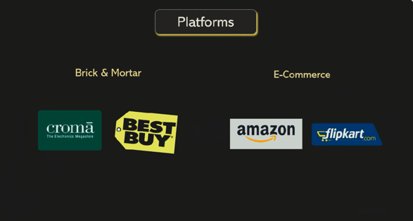
Company Platform and Structure

Slide 9
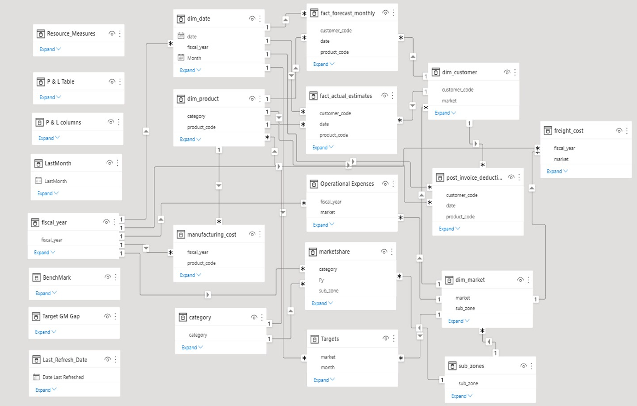
Data Model
﻿
DAX - Explicit Measures
Star Schema - with fact tables in the centre.
Snowflake Schema – Normalizes
dimension tables.

Slide 10
Dashboard

Slide 11
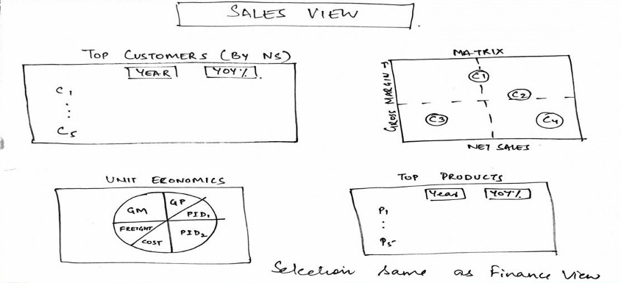
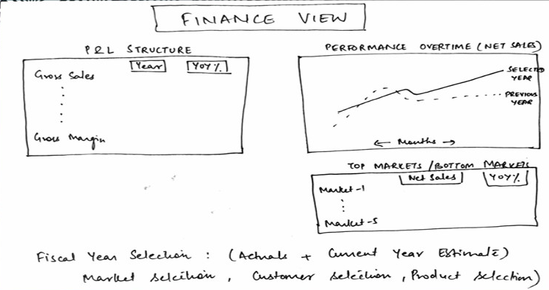
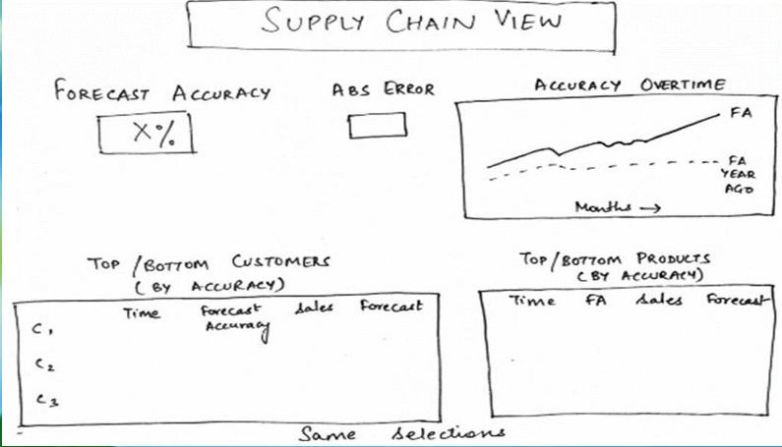
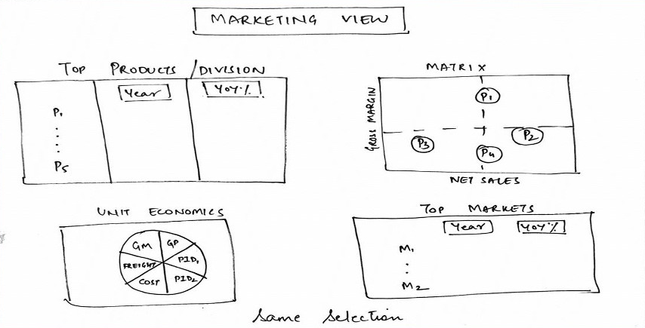
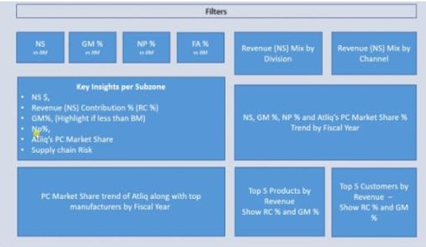
Dashboard Mockup

Slide 12
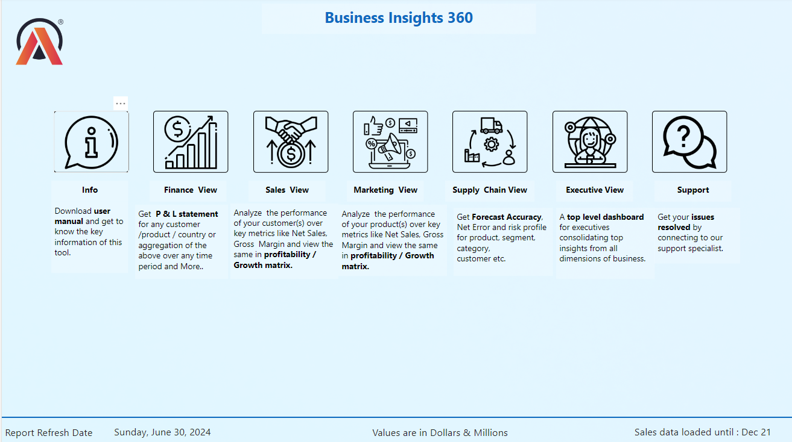
Home

Slide 13
Home

Slide 14
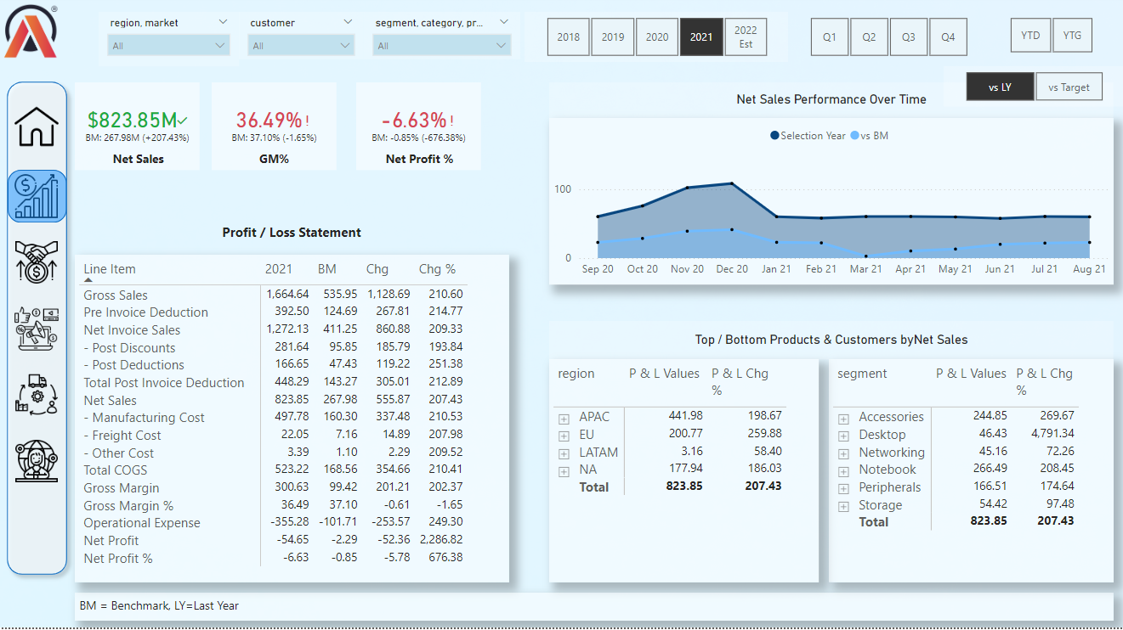
Financial View

Slide 15
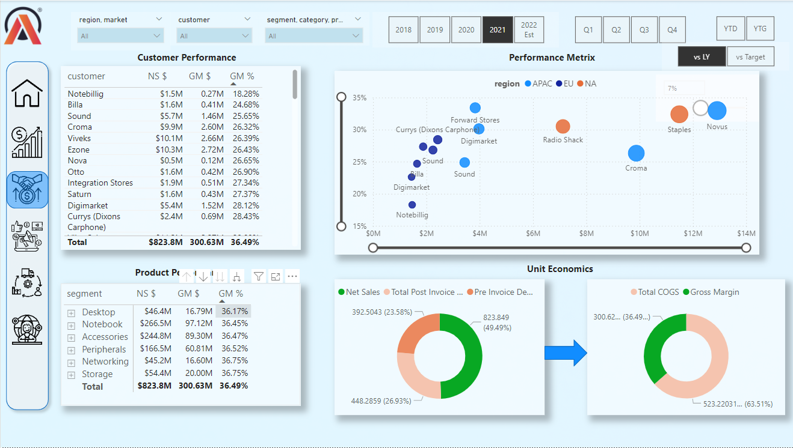
Sales View

Slide 16
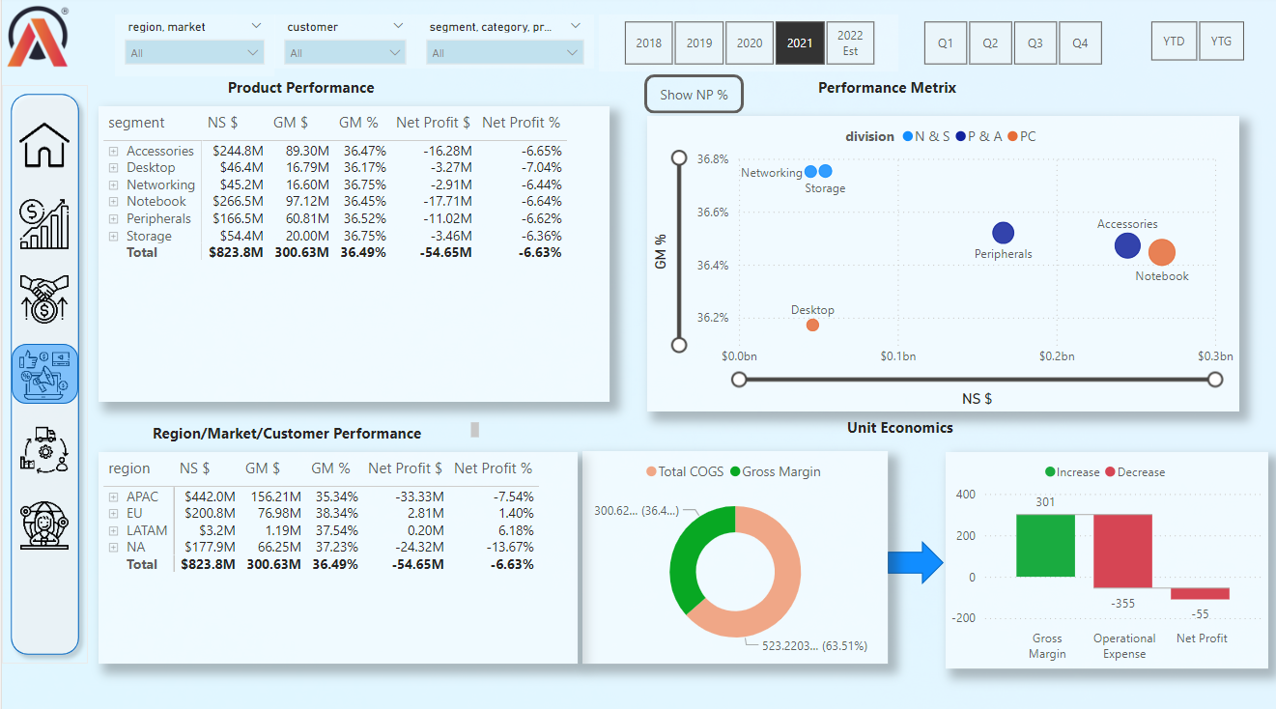
Marketing View

Slide 17
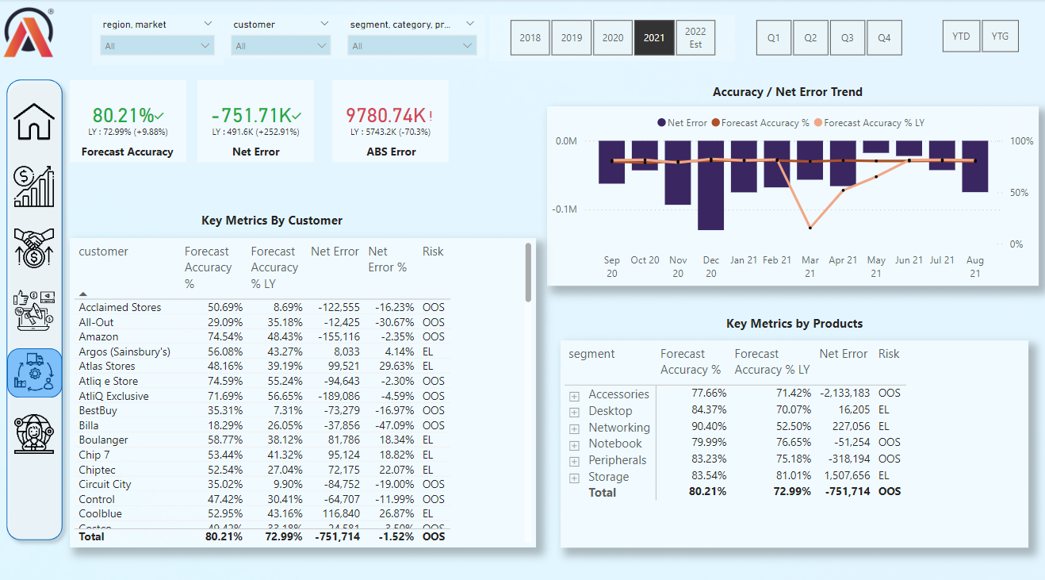
Supply Chain View

Slide 18
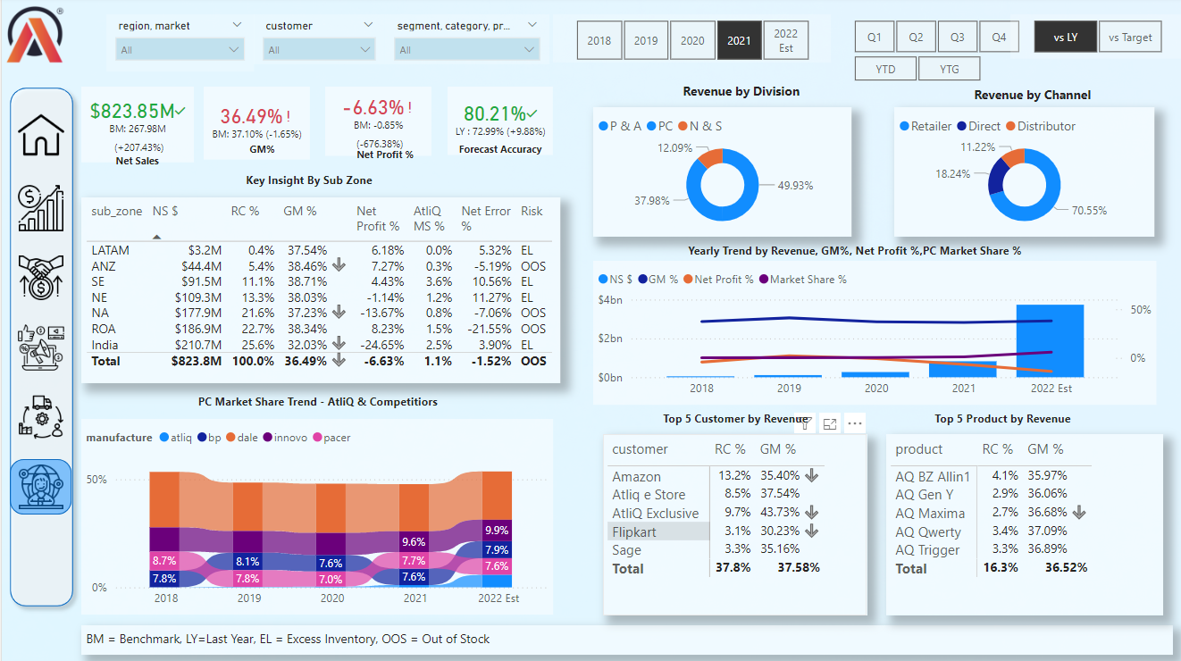
Executive View

Slide 19
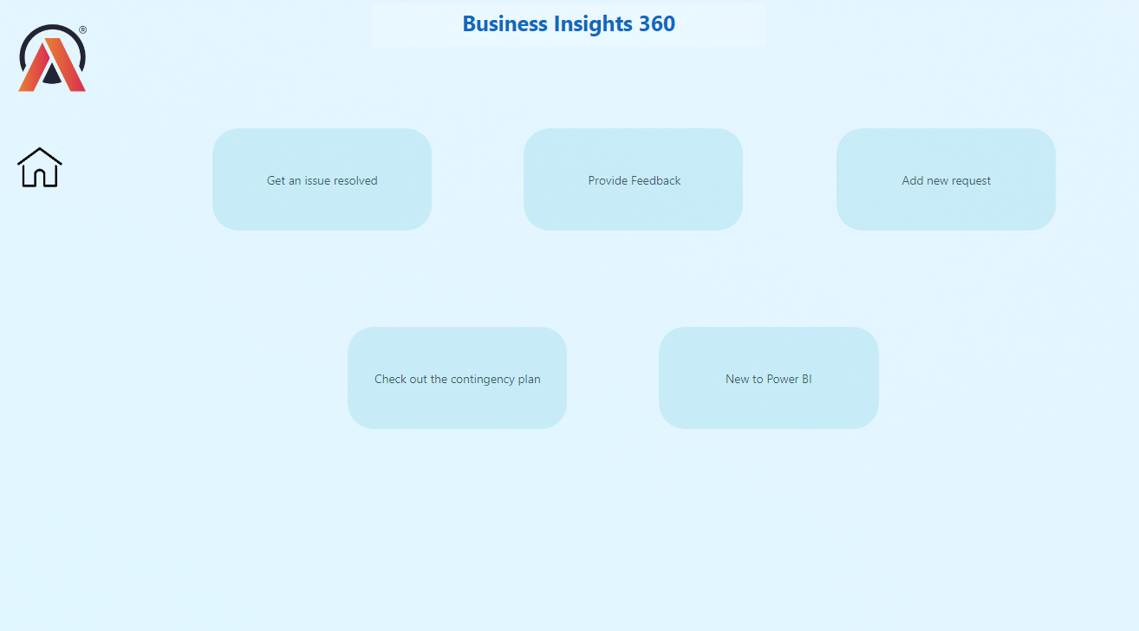
Support View

Slide 20
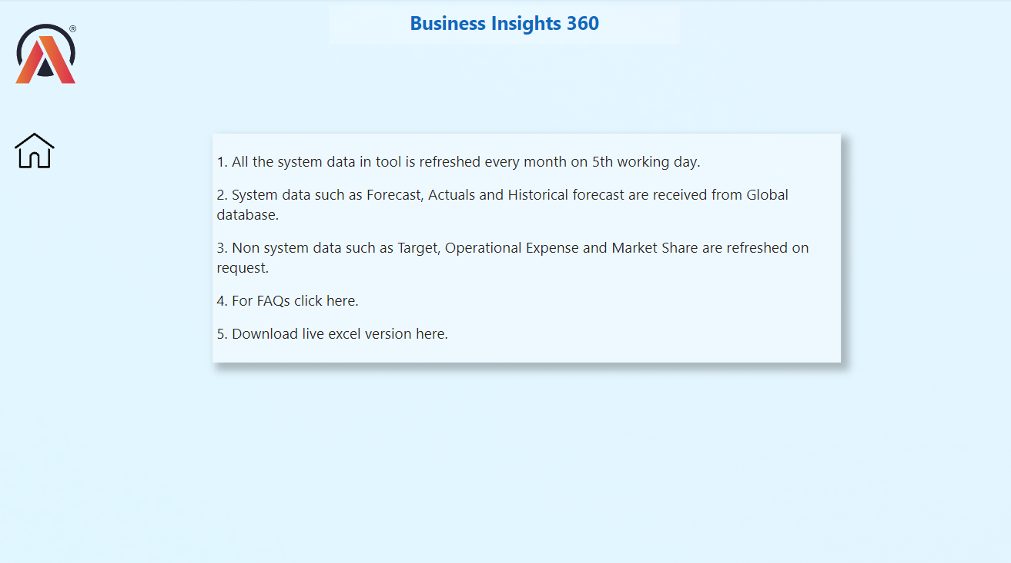
Info View

Slide 21
Key Measures and Formula

Slide 22
Key Measures and Formula
Performance Visual title = [Selected P & L Row] & " Performance Over Time“
Post Invoice Deducation $ = SUM(fact_actual_estimates[post_invoice_deducations_amt])
Post Invoice Other Deducation $ = SUM(fact_actual_estimates[post_invoice_other_deducations_amt])
Pre Invoice Deducation $ = [GS $]-[NIS $]
Quantity = SUM(fact_actual_estimates[Qty])
RC % = DIVIDE([NS $],CALCULATE([NS $],ALL(dim_market),ALL(dim_customer),ALL(dim_product)))
Risk = IF([Net Error]>0,"EL",IF([Net Error]<0,"OOS",BLANK()))
Sales Qty = CALCULATE([Quantity],fact_actual_estimates[date]<=MAX(LastSalesMonth[LastSalesMonth]))
Sales Trend Title = "NS & GM % For "& SELECTEDVALUE(dim_customer[customer])
Selected P & L Row = IF(HASONEVALUE('P & L Rows'[Description]),SELECTEDVALUE('P & L Rows'[Description]),"Net Sales")
Top / Bottom N title = "Top / Bottom Products & Customers by" & [Selected P & L Row]
Total COGS $ = [Manufacturing Cost $]+[Freight Cost $]+[Other Cost $]
Total Post Invoice Deducation $ = 'Key Measures'[Post Invoice Deducation $]+'Key Measures'[Post Invoice Other Deducation $]
NS $ = SUM(fact_actual_estimates[net_sales_amount])
NS $ LY = CALCULATE([NS $],SAMEPERIODLASTYEAR(dim_date[date]))
NS BM $ = SWITCH(TRUE(), SELECTEDVALUE('set BM'[ID])=1,[NS $ LY],
SELECTEDVALUE('set BM'[ID])=2,[NS Target $])
NS Target $ = var rs = SUM(NsGmTarget[ns_target]) RETURN IF([Customer / Product Filter Check],BLANK(),rs)
Operational Expense $ = ([Ads & Promotions $]+[Other Operational Expense $])*-1
Other Cost $ = SUM(fact_actual_estimates[other_cost])
Other Operational Expense $ = SUM(fact_actual_estimates[other_operational_expense])
GM_Percentage = [GM %]
GMComparison = IF([GM %] < [GM Target %], "1", "0")
GS $ = SUM(fact_actual_estimates[gross_sales_amount])
Last Sales Month Footer =
"Sales data loaded until : "& FORMAT(MAX(LastSalesMonth[LastSalesMonth]),"MMM YY")
Manufacturing Cost $ = SUM(fact_actual_estimates[manufacturing_cost])
Market Share % = DIVIDE(SUM(marketshare[sales_$]),SUM(marketshare[total_market_sales_$]),0)
Net Error = [Forecast Qty]-[Sales Qty]
Net Error % = DIVIDE([Net Error],[Forecast Qty],0)
Net Error LY = CALCULATE([Net Error],SAMEPERIODLASTYEAR(dim_date[date]))
Net Profit % = DIVIDE([Net Profit $],[NS $],0)
Net Profit % LY = CALCULATE([Net Profit %],SAMEPERIODLASTYEAR(dim_date[date]))
Net Profit $ = [GM $]+[Operational Expense $]
Net Profit Target % = DIVIDE([Net Profit Target $],SUM(NsGmTarget[ns_target]),0)
Net Profit Target $ = SUM(NsGmTarget[np_target])
NIS $ = SUM(fact_actual_estimates[net_invoice_sales_amount])
NP % BM = SWITCH(TRUE(), SELECTEDVALUE('set BM'[ID])=1,[Net Profit % LY],
SELECTEDVALUE('set BM'[ID])=2,[Net Profit Target %])

Slide 23
Key Measures and Formula
ABS Error = SUMX(DISTINCT(dim_date[date]),SUMX(DISTINCT(dim_product[product_code]),ABS([Net Error])))
ABS Error % = DIVIDE([ABS Error],[Forecast Qty],0)
ABS Error LY = CALCULATE([ABS Error],SAMEPERIODLASTYEAR(dim_date[date]))
Ads & Promotions $ = SUM(fact_actual_estimates[ads_promotations])
AtliQ MS % = CALCULATE([Market Share %],marketshare[manufacture]="atliq")
BM Message = IF([NS BM $]=BLANK()||[GM % BM]=BLANK()||[NP % BM]=BLANK(),"BM Target (s) is not available for selected year","")
Custome_heilght = IF([GM %] < [GM Target %], "Red", "No color")
Customer / Product Filter Check = ISCROSSFILTERED(dim_product[product]) || ISFILTERED(dim_customer[customer])
Forecast Accuracy % = IF([ABS Error %]<> BLANK(),1- [ABS Error %],BLANK())
Forecast Accuracy % LY = CALCULATE([Forecast Accuracy %],SAMEPERIODLASTYEAR(dim_date[date]))
Forecast Qty = var lslastdate = MAX(LastSalesMonth[LastSalesMonth]) RETURN
CALCULATE(SUM(fact_forecast_monthly[forecast_quantity]),fact_forecast_monthly[date]<=lslastdate)
Freight Cost $ = SUM(fact_actual_estimates[freight_cost])
GM
GM / Unit = DIVIDE([GM $],[Quantity],0)
GM % = DIVIDE([GM $],[NS $],0)
GM % BM = SWITCH(TRUE(), SELECTEDVALUE('set BM'[ID])=1,[GM % LY], SELECTEDVALUE('set BM'[ID])=2, [GM Target %])
GM % Filter = IF([GM % Variance]>=SELECTEDVALUE('Target Gap Tolerances'[Target Gap Tolerances]),1,0)
GM % LY = CALCULATE([GM %],SAMEPERIODLASTYEAR(dim_date[date]))
GM % Variance = [GM % BM]-[GM %]
GM $ = [NS $]-[Total COGS $]
GM Target % = DIVIDE([GM Target $],SUM(NsGmTarget[ns_target]),0)
GM Target $ = SUM(NsGmTarget[gm_target])
P & L
P & L BM = SWITCH(TRUE(), SELECTEDVALUE('set BM'[ID])=1,[P & L LY],
SELECTEDVALUE('set BM'[ID])=2,[P & L Target] )
P & L Chg = var res = [P & L Values]-[P & L BM] RETURN IF(ISBLANK([P & L BM])|| ISBLANK([P & L Values]),BLANK(),res)
P & L Chg % = var res = DIVIDE([P & L Chg],[P & L BM],0)*100 RETURN IF(ISBLANK([P & L BM])|| ISBLANK([P & L Values]),BLANK(),res)
P & L Final Value = SWITCH(TRUE(),SELECTEDVALUE(fiscal_year[fy_desc])=MAX('P & L Column'[Col Header]),[P & L Values],MAX('P & L Column'[Col Header])="BM",[P & L BM],MAX('P & L Column'[Col Header])="Chg",[P & L Chg],MAX('P & L Column'[Col Header])="Chg %",[P & L Chg %])
P & L LY = CALCULATE([P & L Values],SAMEPERIODLASTYEAR(dim_date[date]))
P & L Target = VAR res =SWITCH(TRUE(),MAX('P & L Rows'[Order]) =7, [NS Target $]/1000000,MAX('P & L Rows'[Order]) =12, [GM Target $]/1000000,MAX('P & L Rows'[Order]) =13, [GM Target %]*100,MAX('P & L Rows'[Order]) =16, [Net Profit Target $]/1000000,MAX('P & L Rows'[Order]) =17, [Net Profit Target %]*100) RETURN IF(HASONEVALUE('P & L Rows'[Description]),res,[NS Target $]/1000000)
P & L Values = VAR res =SWITCH(TRUE(),MAX('P & L Rows'[Order]) =1, [GS $]/1000000,MAX('P & L Rows'[Order]) =2, [Pre Invoice Deducation $]/1000000,MAX('P & L Rows'[Order]) =3, [NIS $]/1000000,MAX('P & L Rows'[Order]) =4, [Post Invoice Deducation $]/1000000,MAX('P & L Rows'[Order]) =5, [Post Invoice Other Deducation $]/1000000,MAX('P & L Rows'[Order])=6,[Post Invoice Deducation $]/1000000+[Post Invoice Other Deducation $]/1000000,MAX('P & L Rows'[Order]) =7, [NS $]/1000000,MAX('P & L Rows'[Order]) =8, [Manufacturing Cost $]/1000000,MAX('P & L Rows'[Order]) =9, [Freight Cost $]/1000000,MAX('P & L Rows'[Order]) =10, [Other Cost $]/1000000,MAX('P & L Rows'[Order]) =11,[Total COGS $]/1000000,MAX('P & L Rows'[Order]) =12, [GM $]/1000000,MAX('P & L Rows'[Order]) =13, [GM %]*100,MAX('P & L Rows'[Order]) =15, [Operational Expense $]/1000000,MAX('P & L Rows'[Order]) =16, [Net Profit $]/1000000,MAX('P & L Rows'[Order]) =17, [Net Profit %]*100) RETURN IF(HASONEVALUE('P & L Rows'[Description]),res,[NS $]/1000000)

Slide 24
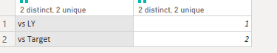
Column DAX and Query(M) Formula
P & L Column = var x=ALLNOBLANKROW(fiscal_year[fy_desc]) RETURN UNION(ROW("Col Header","BM"), ROW("Col Header","Chg"),ROW("Col Header","Chg %"),x)
sub_zone = ALLNOBLANKROW(dim_market[sub_zone])
Target Gap Tolerances = GENERATESERIES(0, 0.2, 0.01)
fy_desc = var MAXDATE= CALCULATE(MAX(fiscal_year[fiscal_year]),ALL(fiscal_year[fiscal_year]))
RETURN IF(fiscal_year[fiscal_year]=MAXDATE,MAXDATE & " Est",fiscal_year[fiscal_year])
Power Query Table and Column
= {Number.From(#date(2017,9,1))..Number.From(#date(2022,12,31))} List to table
Insert start month: = Table.AddColumn(#"Renamed Columns", "Start of Month", each Date.StartOfMonth([date]), type date)
Custom column: = Table.AddColumn(#"Renamed Columns1", "fiscal_year", each Date.Year(Date.AddMonths([month],4))) OR =Date.Year(Date.AddMonths([month],4))
= Table.SelectRows(#"Changed Type1", each ([fiscal_year] <> "2023")) --not <>
New table sourse: = #table(type table[Report Load Refreshed =datetime],{{DateTime.LocalNow()}})
Gross_sale_amount: =[Qty]*[gross_price] in custom column
pre_invoice_discount_amount: =[gross_sales_amount]*[pre_invoice_discount_pct] in custom column
net_invoice_sales_amount: = [gross_sales_amount]-[pre_invoice_discount_amount] in custom column
LastSalesmonth: = List.Max(fact_sales_monthly[date])
Filter; = Table.SelectRows(Source, each ([date] > LastSalesMonth))
= Table.TransformColumnTypes(Source,{{"Benchmark", type text}, {"ID", Int64.Type}})

Slide 25
Thank you
Live Dashboard PowerBi: Click here
Github: Click here

